Slide 1


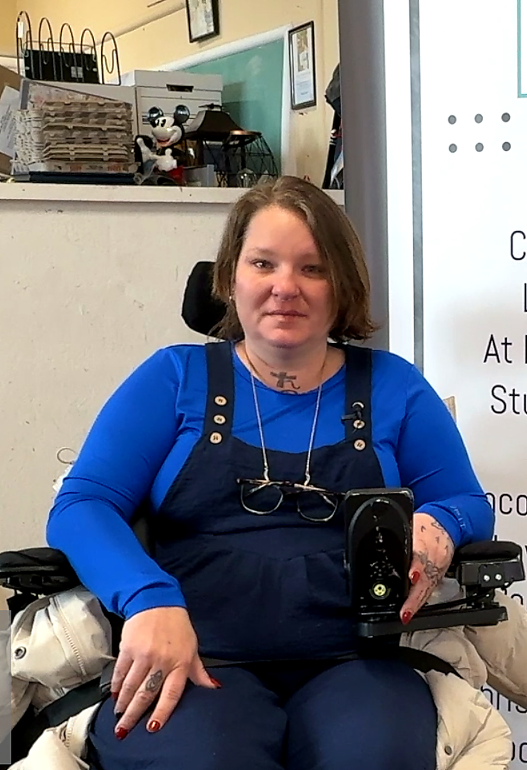


Your gift helps a local family
stay fed and hopeful
A workplace injury left Carolann weeks from homelessness. Thanks to donors like you, she can still put food on the table for her family.
Join our workplace giving campaign today!
(insert link to pledge form)

Slide 2
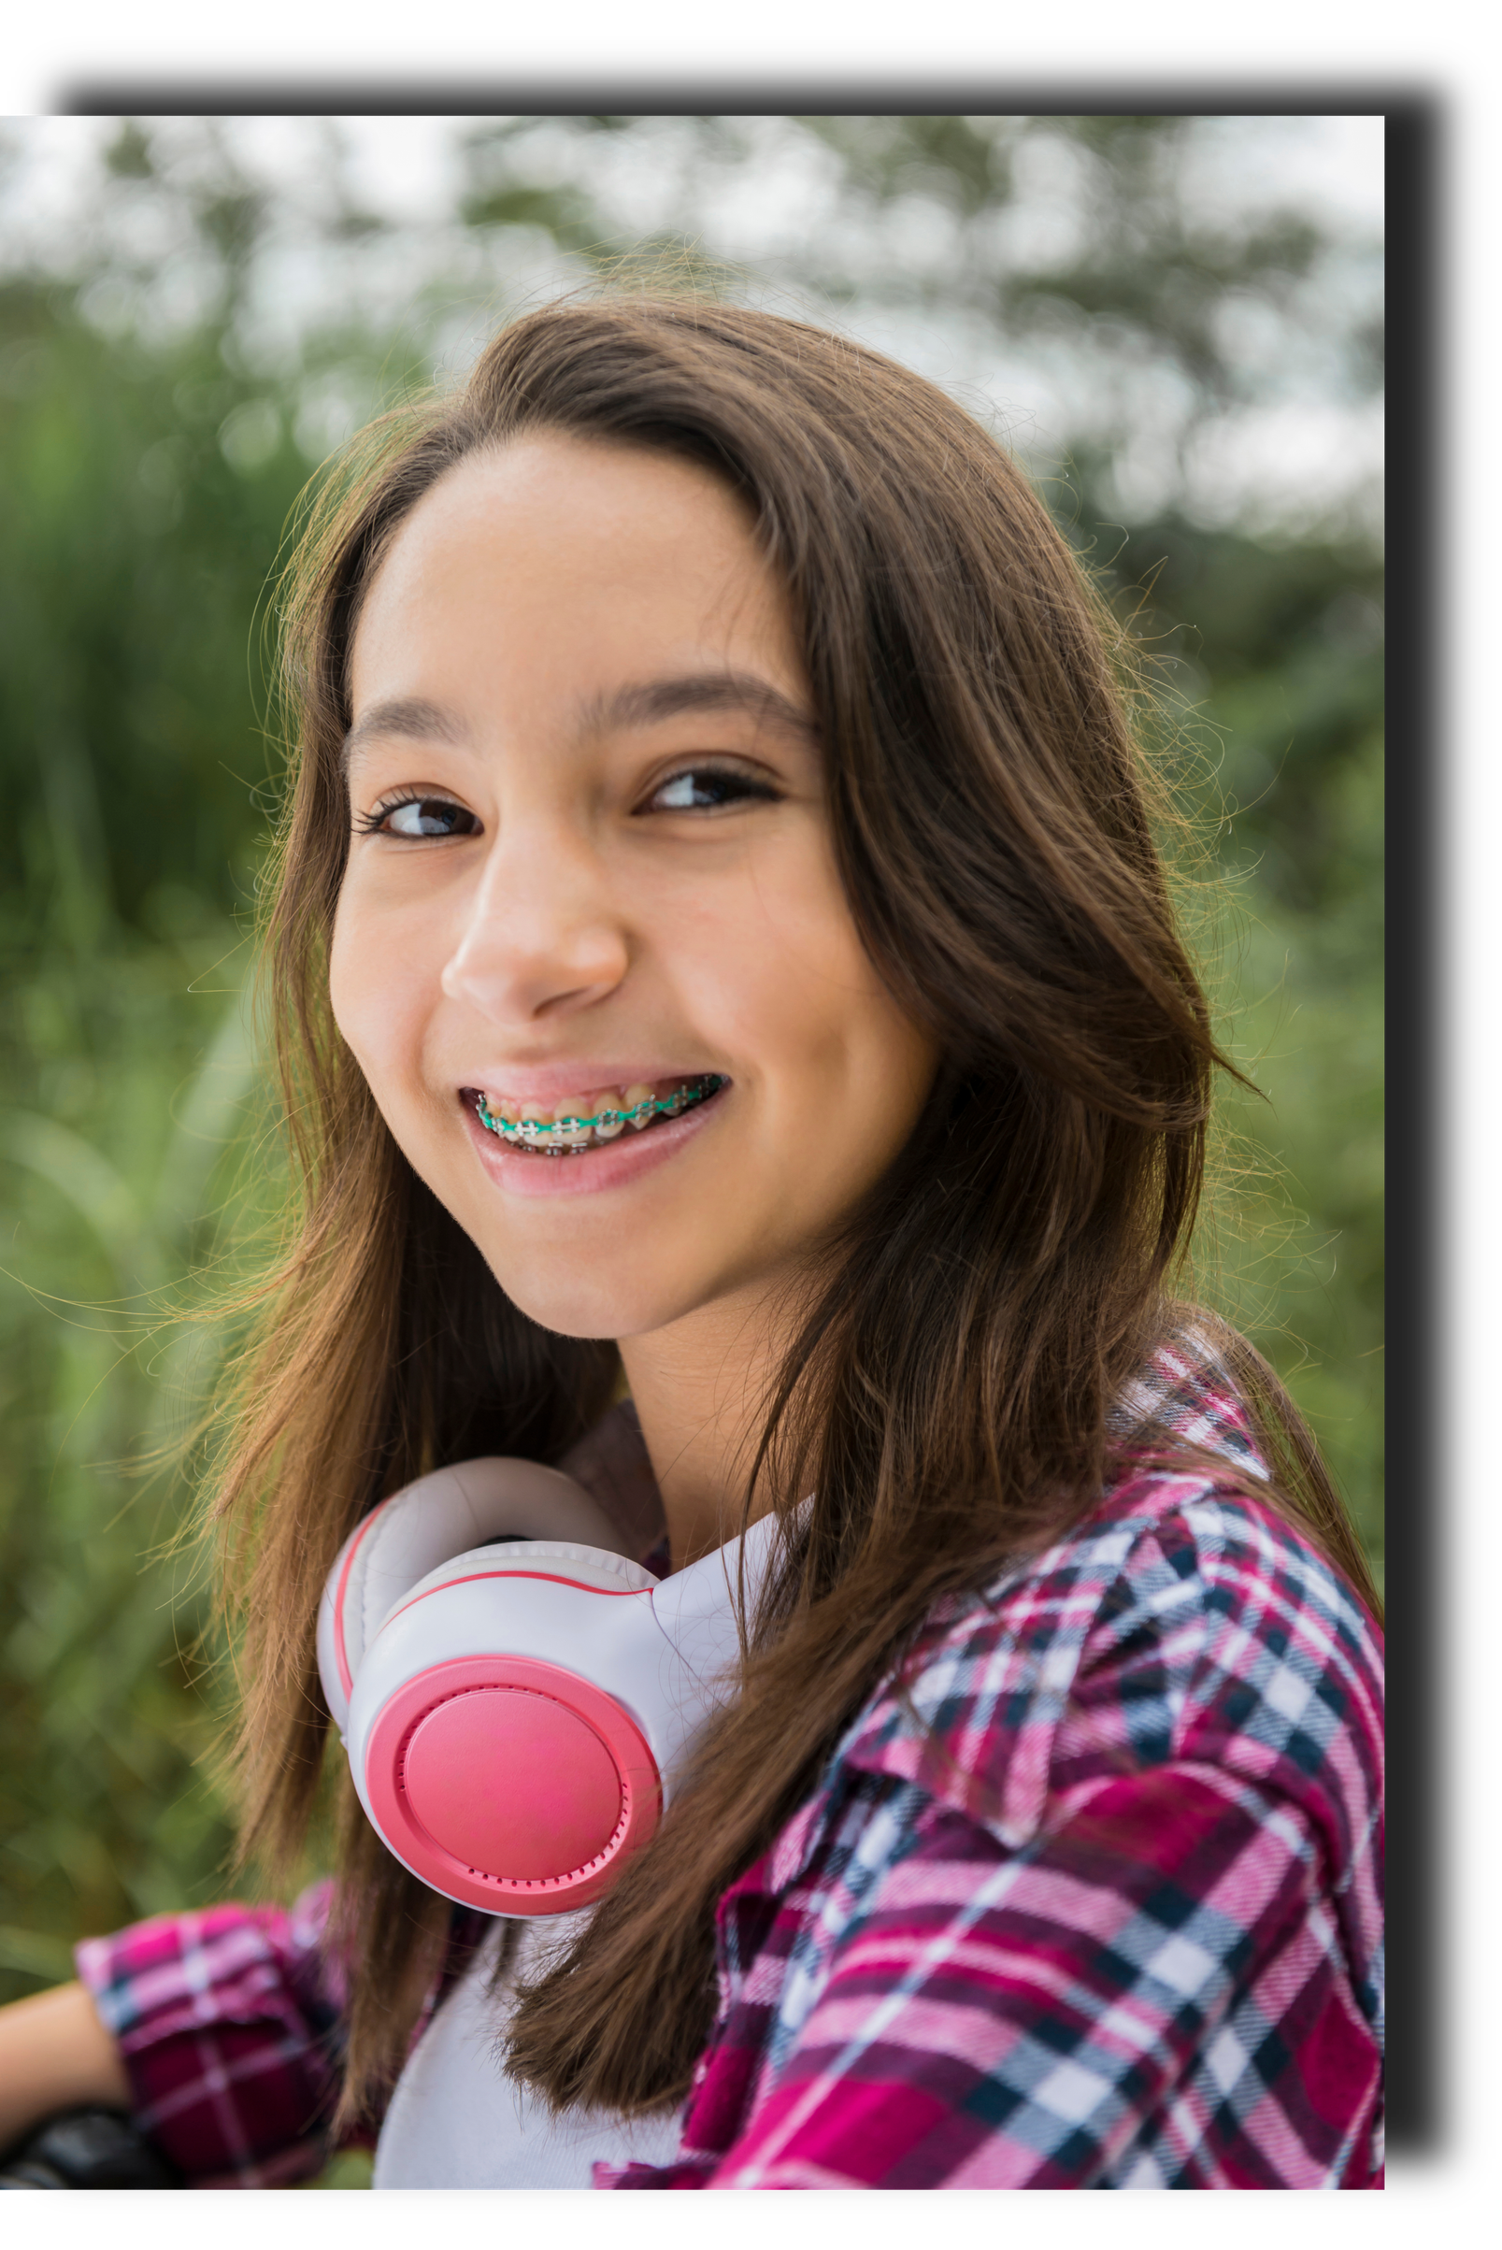
Your gift helps a teen build
a healthier future
Substance use and mental health struggles once threatened
Michelle's future. Thanks to donors like you, she got back
on track and graduated ahead of schedule.
Join our workplace giving campaign today!
(insert link to pledge form)
**image et nom modifiés pour protéger l'identité

Slide 3
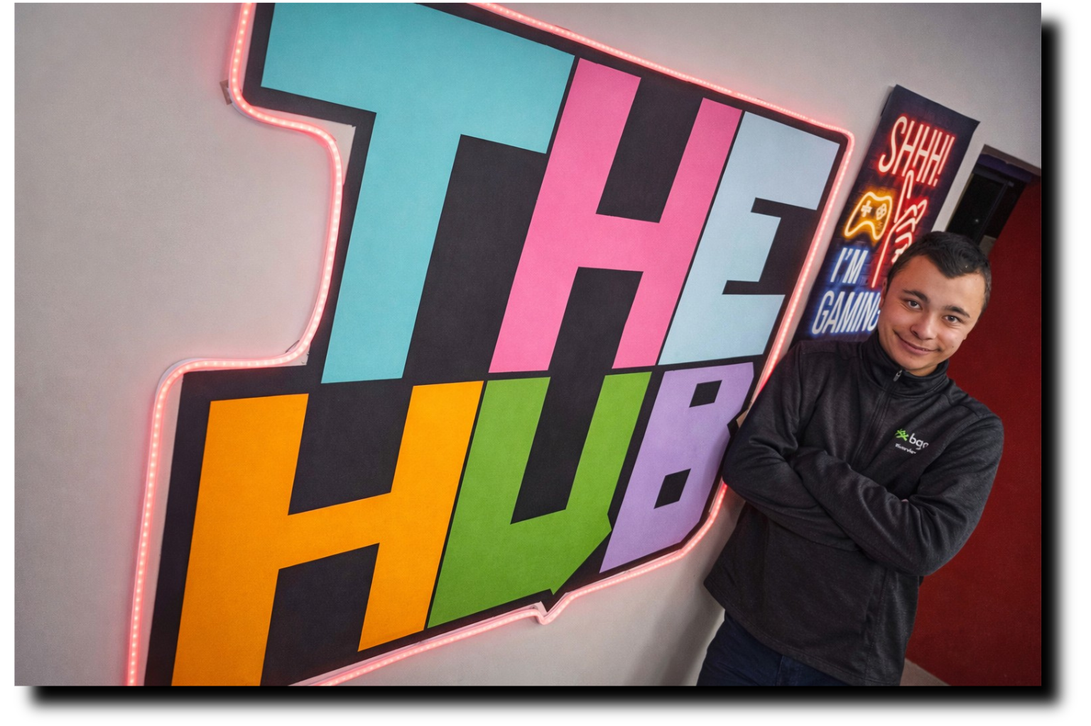
Your gift helped Sam find
belonging.
Thanks to donors like you, an after-school program gave
Sam a safe space welcoming youth of all abilities. He's
grown from a participant into a confident volunteer
and mentor for younger kids.
Join our workplace giving campaign today!
(insert link to pledge form)

Slide 4
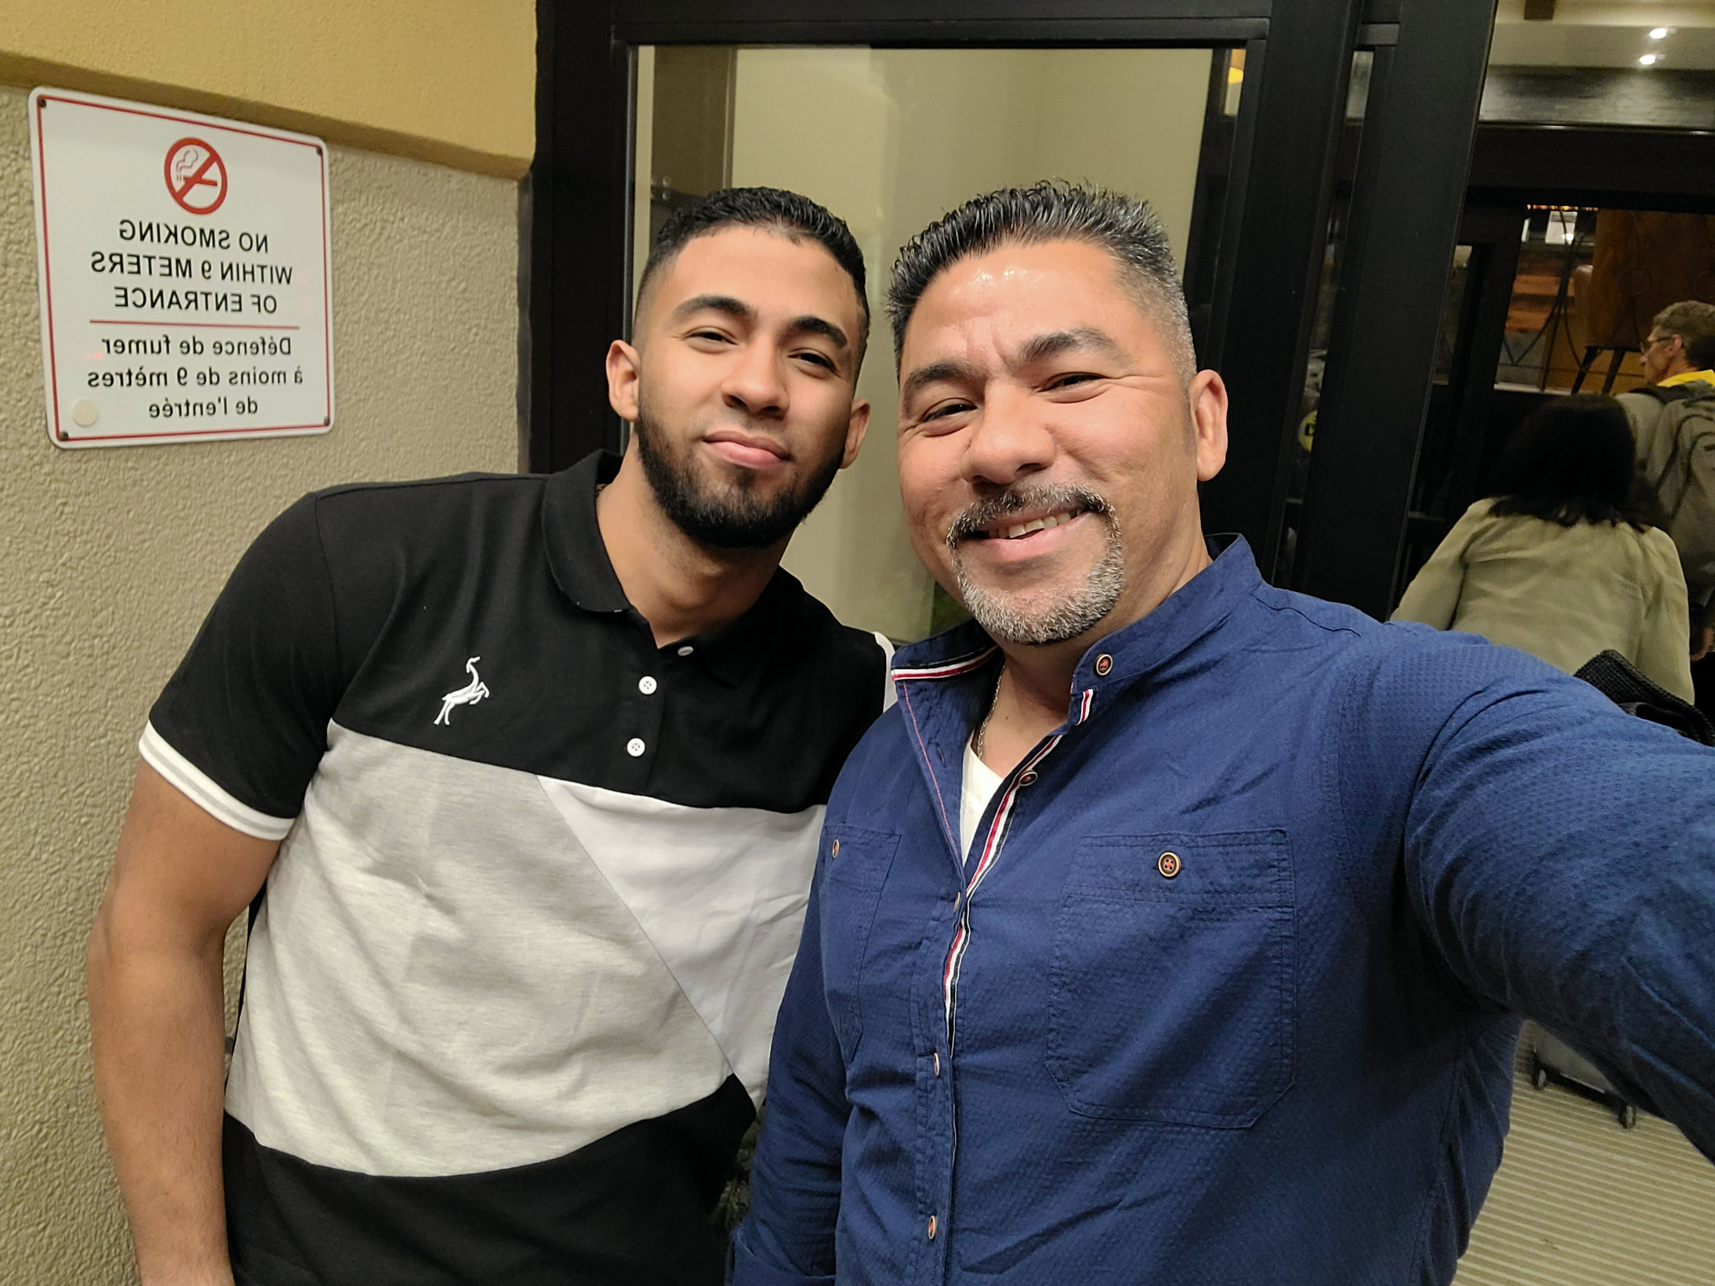
Your gift helped *Eric find
safety.
Political unrest in Venezuela forced Eric and hus son to flee
his home, leaving family behind on a year-long journey to
safety. Thanks to donors like you, the NB Refugee Clinic
is helping him rebuild a life in Canada.
Join our workplace giving campaign today!
(insert link to pledge form)
*name changed to protect identity

